Slide 1
Cryptography Encryption and Decryption
SQLite

Slide 2
What are the three types of cryptography?
Symmetric key cryptography.
Asymmetric key cryptography.
Hash Function
https://www.youtube.com/watch?v=AQDCe585Lnc
https://www.youtube.com/watch?v=2BldESGZKB8

Slide 3
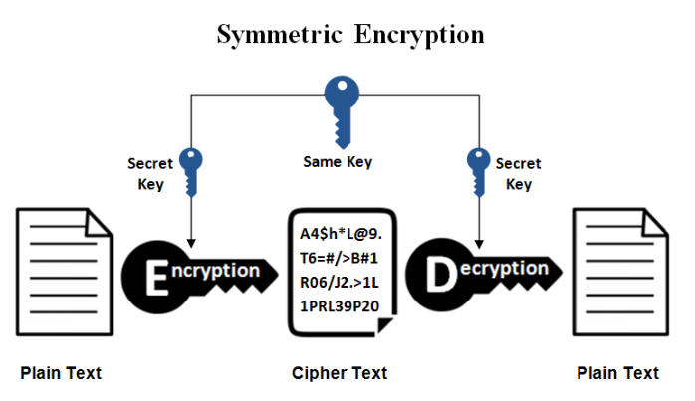
Symmetric Encryption
Uses one key to encrypt and decrypt. If you encrypt a zip file, and then decrypt with the same key, you are using symmetric encryption. Symmetric encryption is also called “secret key” encryption, as the key must be kept secret from third parties.

Slide 4
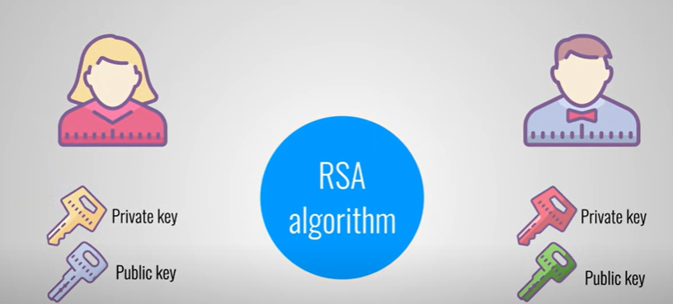
Asymmetric Encryption
Exchanging public keys
AES is a symmetric algorithm designed for rapid data encryption and decryption, RSA is an asymmetric method used primarily for secure key exchange and digital signatures.

Slide 5
Encryption and Decryption
Encryption is the process of translating plain text data (plaintext) into something that appears to be random and meaningless (ciphertext). Decryption is the process of converting ciphertext back to plaintext.

Slide 6
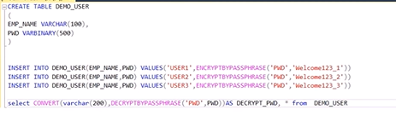
SQL Encryption: functions

Slide 7
SQL: Cryptographic functions
https://learn.microsoft.com/en-us/sql/t-sql/functions/cryptographic-functions-transact-sql?view=sql-server-ver16#symmetric-encryption-and-decryption

Slide 8
A hash function
A hash function is a mathematical function that converts any digital data into an output string with a fixed number of characters. Hashing is the one-way act of converting the data (called a message) into the output (called the hash).
a hash function is a deterministic procedure that takes an input (or “message”) and returns a string of characters of a fixed size—which is usually a “digest”—that is unique to the input

Slide 9
What is a strength of using a hashing function?
Hashing functions provide a way to verify the integrity of data. By storing and comparing hash values, you can quickly determine if data has been modified or corrupted. Even a small change to the input data will result in a significantly different hash value.

Slide 10
SHA, ( Secure Hash Algorithms )
SHA, ( Secure Hash Algorithms ) are set of cryptographic hash functions defined by the language to be used for various applications such as password security etc. Some variants of it are supported by Python in the “hashlib” library.

Slide 11
SQLite - hash functions
Use this crate to add various hash functions to SQLite, including MD5, SHA1, SHA224, SHA256, SHA384, and SHA512.
insert into login_details values(SHA1("user2"), SHA1(“12345"));
insert into login_details values(SHA224("user2"),SHA224("2345"));
https://www.geeksforgeeks.org/sha-in-python/

Slide 12
Encryption can be decrypted.
Hashes are one way - they are irreversible.
from cryptography.fernet import Fernet
# we will be encrypting the below string.
message = "hello"
# generate a key for encryption and decryption
# You can use fernet to generate
# the key or use random key generator
# here using fernet to generate key
key = Fernet.generate_key()
# Instance the Fernet class with the key
fernet = Fernet(key)
# then use the Fernet class instance
# to encrypt the string string must
# be encoded to byte string before encryption
encMessage = fernet.encrypt(message.encode())
print("original string: ", message)
print("encrypted string: ", encMessage)
# decrypt the encrypted string with the
# Fernet instance of the key,
# that was used for encrypting the string
# encoded byte string is returned by decrypt method,
# so decode it to string with decode methods
decMessage = fernet.decrypt(encMessage).decode()
print("decrypted string: ", decMessage)

Slide 13
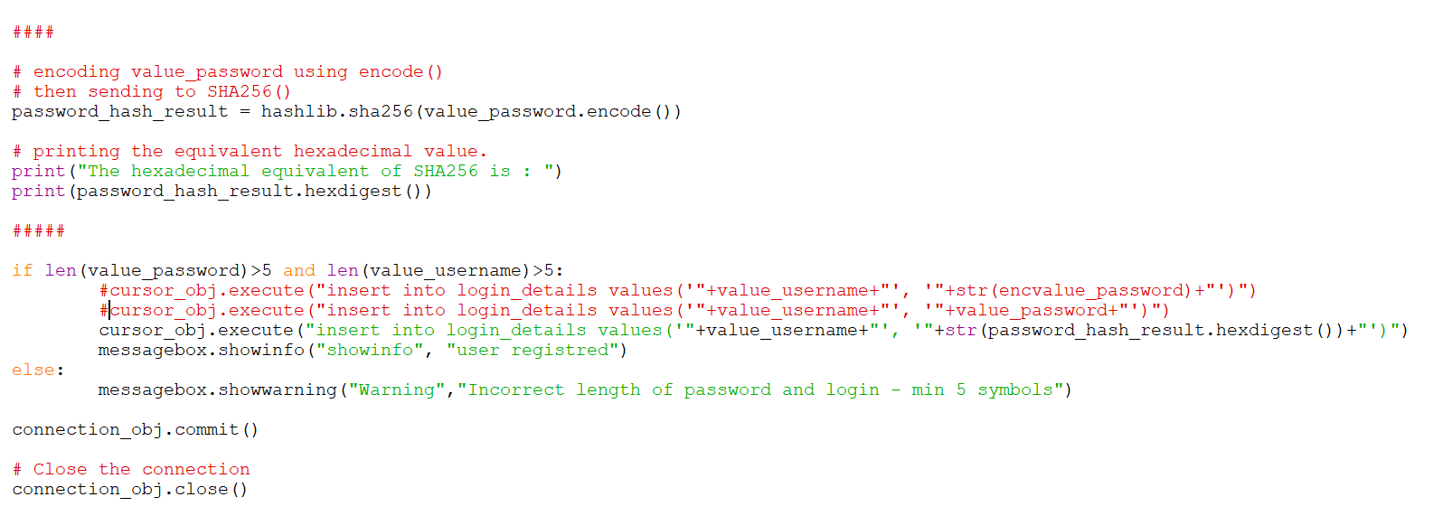
Python Tkinter SQLite HASH

Slide 14
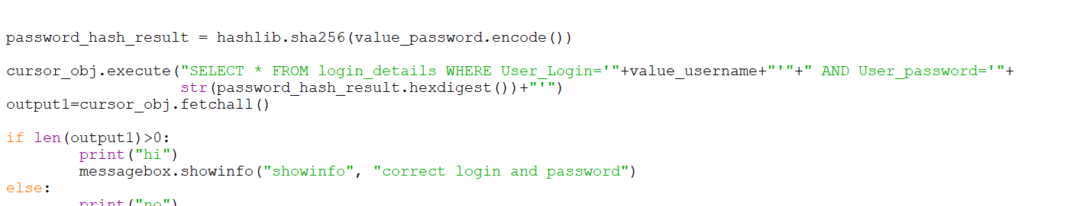
Python Tkinter SQLite HASH

Slide 15
Task: Create Python Tkinter - SQL application
Use online shopping database:
Encrypt - decrypt logins and passwords
Encrypt - user information (address, bank details…)
use hash function(s ) or encrypt/decrypt
Next Lesson readings:
NoSQL database exchanging data with Python

Slide 16
Example: Simple way to encrypt and decrypt
#encrypt
message = "Hello, do you know my password is pasword123?"
translated =""
i = len(message) - 1
while i >= 0 :
translated = translated + message[i]
i = i - 1
print(translated)
#decrypt
message =""
i = len(translated) - 1
while i >= 0 :
message = message + translated[i]
i = i - 1
print(message)

